Slide 1
Diabetes Prediction
BY- OM MEHROTRA
OM VAJPAYEE
MOHD. YAHYA RIZWAN

Slide 2
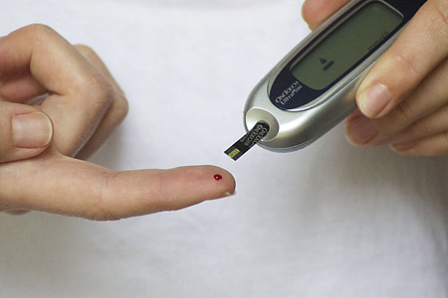
INTRODUCTION
Diabetes is a disease that occurs when your blood glucose, also called blood sugar, is too high.
Diabetes raises the risk for damage to the eyes, kidneys, nerves, and heart.
Diabetes is also linked to some types of cancer. Taking steps to prevent or manage diabetes may lower your risk of developing diabetes health problems.

Slide 3
SCOPE OF PROJECT
The objective of the dataset is to predict whether or not a patient has diabetes, based on certain diagnostic measurements included in the dataset.
The datasets consists of several medical predictor variables and one target variable, Outcome.
Predictor variables includes the number of pregnancies the patient has had, their BMI, insulin level, age, and so on.

Slide 4
Sources
Libraries used :
seaborn
matplotlib
pandas
numpy
scikit_learn
Dataset url : https://www.kaggle.com/uciml/pima-indians-diabetes-database

Slide 5
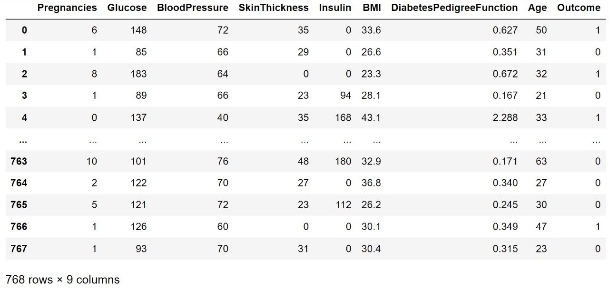
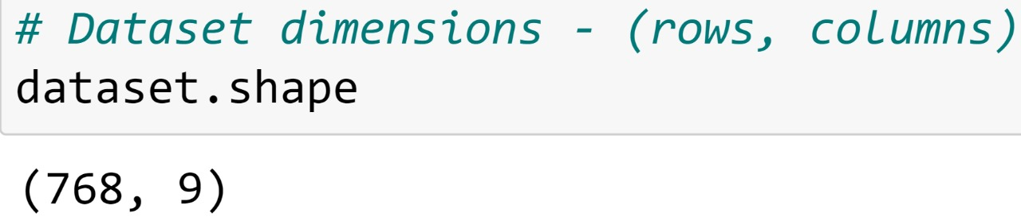
Data Set
There are a total of 768 records and 9 features in the dataset.

Slide 6
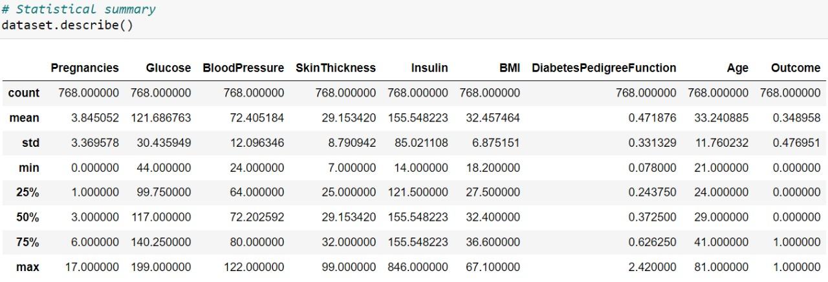
Data Set
Observations:
There are a total of 768 records and 9 features in the dataset.
Each feature can be either of integer or float datatype. Some features like Glucose, Blood pressure , Insulin, BMI have zero values which represent missing data.
There are zero NaN values in the dataset. In the outcome column, 1 represents diabetes positive and 0 represents diabetes negative.

Slide 7
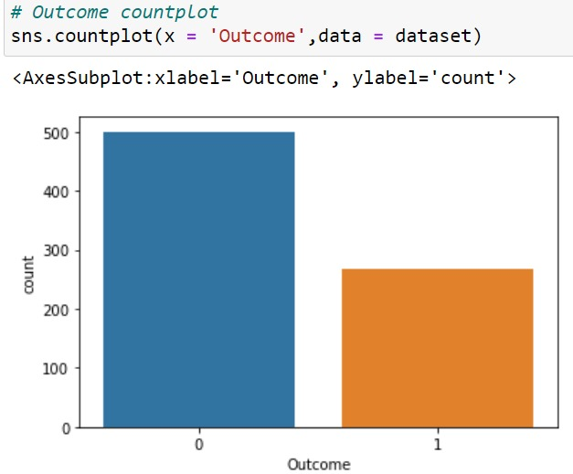
Outcome Countplot
1 represents diabetes positive
0 represents diabetes negative
The countplot tells us that the dataset is imbalanced, as number of patients who don't have diabetes is more than those who do.

Slide 8
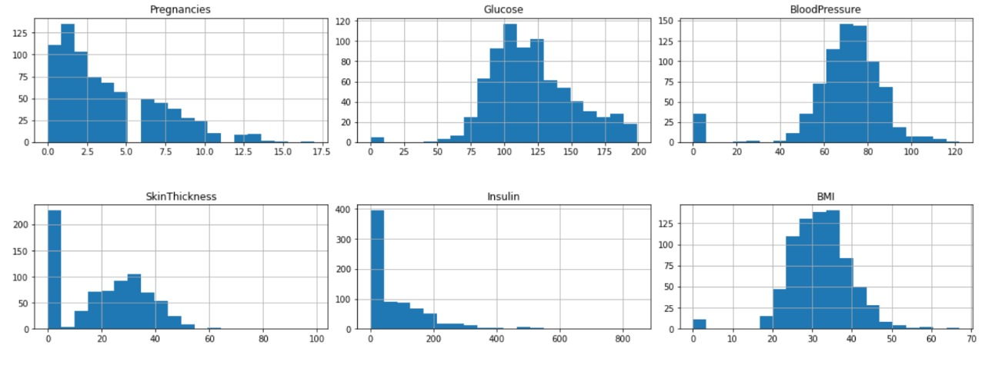
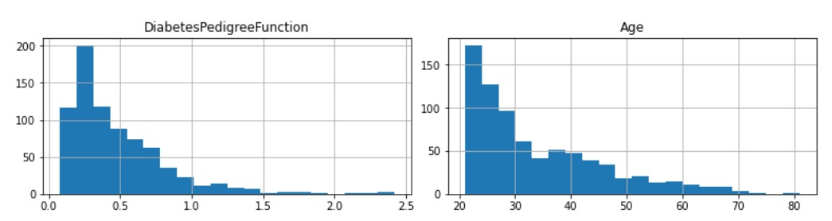
Histogram of Datasets

Slide 9
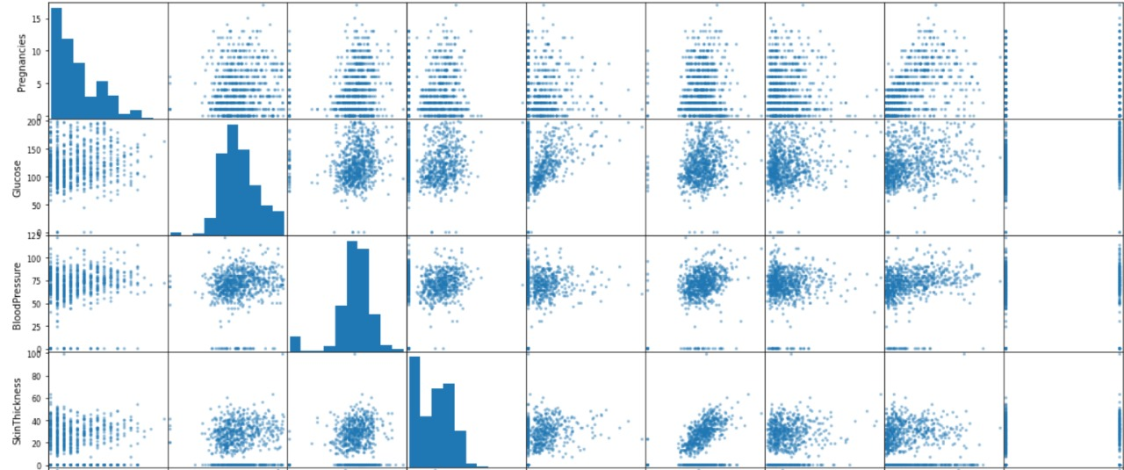
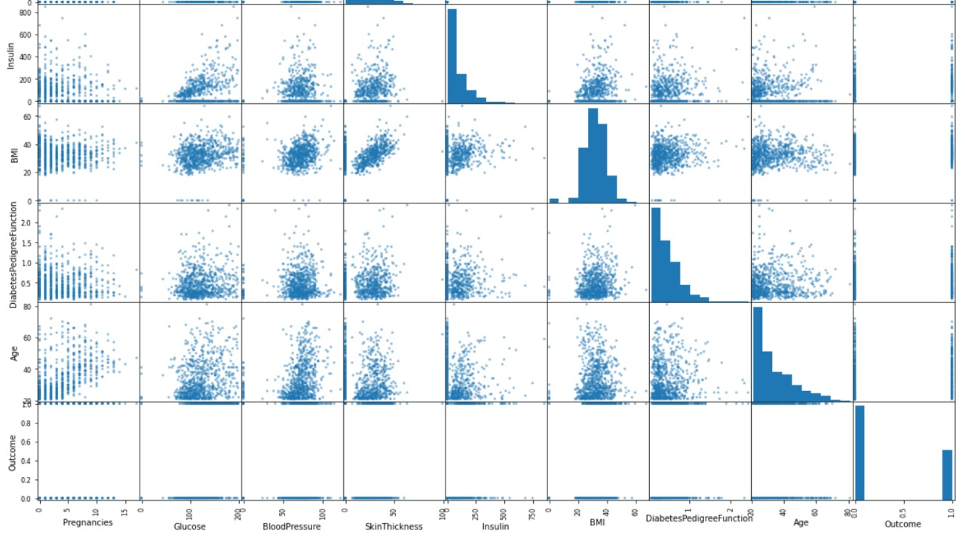
Scatter Plot Used to determine whether or not 2 variables have relation or correlation

Slide 10
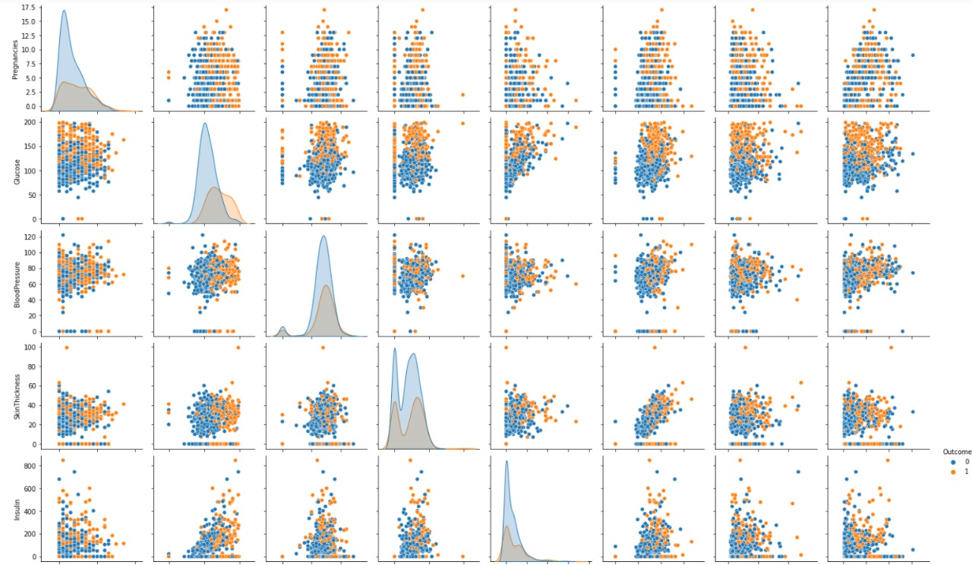
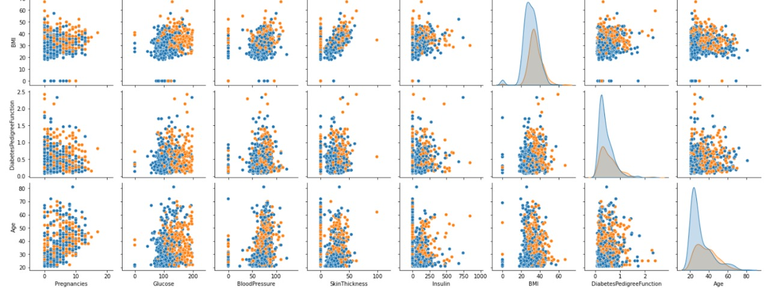
Pairplot

Slide 11
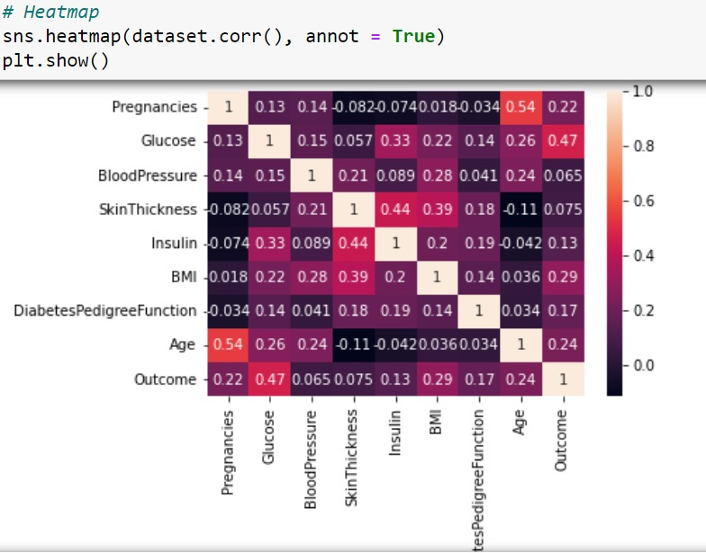
HeatMap for Correlation
From the correlation heatmap, we can see that there is a high correlation between Outcome and [Glucose,BMI,Age,Insulin]. We can select these features to accept input from the user and predict the outcome.

Slide 12
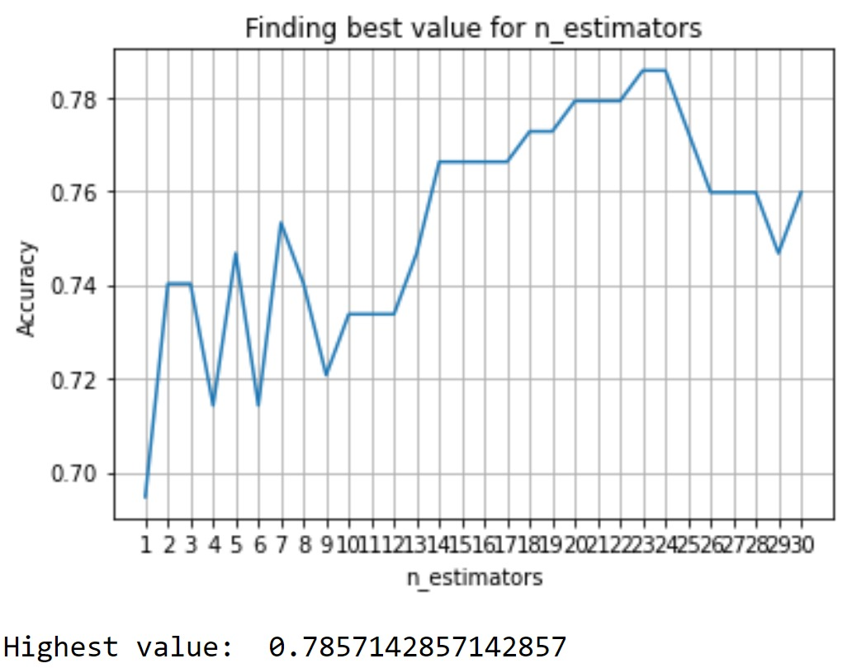
Graph for n neighbours

Slide 13
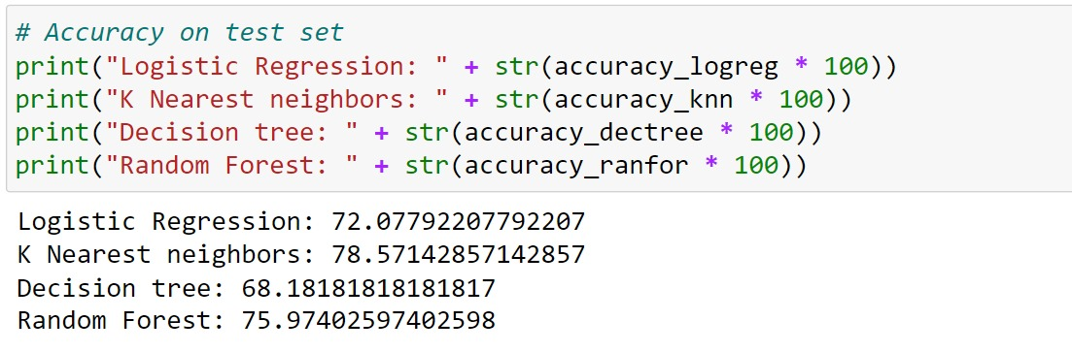
Accuracy on Test Set
From the above comparison, we can observe that K Nearest neighbors gets the highest accuracy of 78.57 %

Slide 14
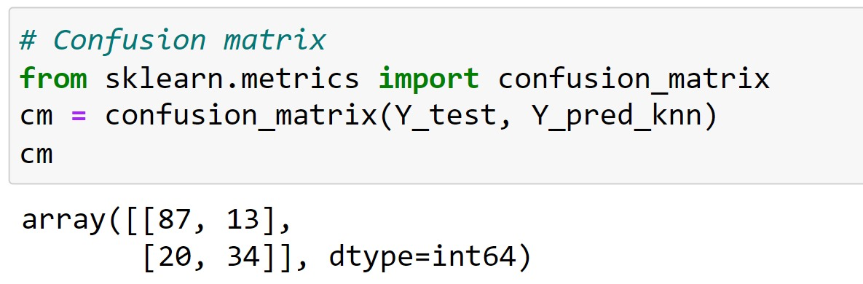
Confusion Matrix
A confusion matrix is a table that is used to define the performance of a classification algorithm. A confusion matrix visualizes and summarizes the performance of a classification algorithm.

Slide 15
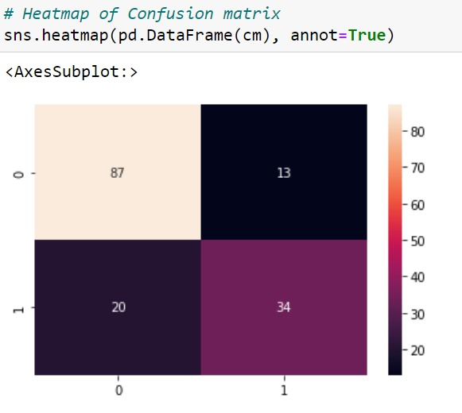
Heat Map of Confusion Matrix

Slide 16
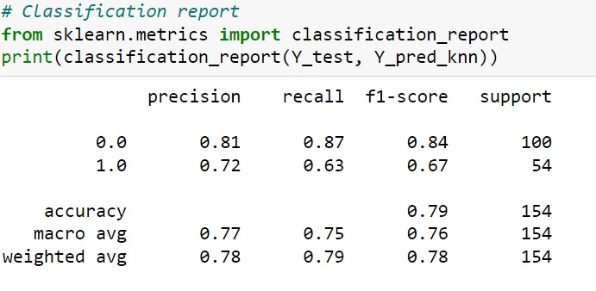
Classification Report A classification report is a performance evaluation metric in machine learning. It is used to show the precision, recall, F1 Score, and support of your trained classification model. Precision: The quality of a positive prediction made by the model Recall: The percentage of data samples that a machine learning model correctly identifies as belonging to a class of interest—the “positive class”—out of the total samples for that class. F1-score: Harmonic mean of precision and recall Support: Support is the number of actual occurrences of the class in the specified dataset.

Slide 17
THANK YOU

